Slide 1
Insights

Slide 2
Insights
Each visual tile on your dashboard is a doorway into data exploration.
Run insights to generate interesting interactive visuals based on your data.
When you run insights, Power BI does the data exploration for you.

Slide 3
Creating of Insights
Insights can be created by either of the 3 ways:
Insights can be run on a specific Tile of an existing Dashboard.
Insights also can be created without creating any Report and Dashboard. Simply Insight can be created using Published DataSets. The output of Insight becomes a Tile. We have choice of pinning it to an existing Dashboard or even putting in a fresh new Dashboard.
So, if you pin that output to a new Dashboard then that Dashboard will NOT be based on any report.
Insights also can be created immediately after successfully publishing the report!! Simply a new dashboard gets created showing the insights!!!!

Slide 4
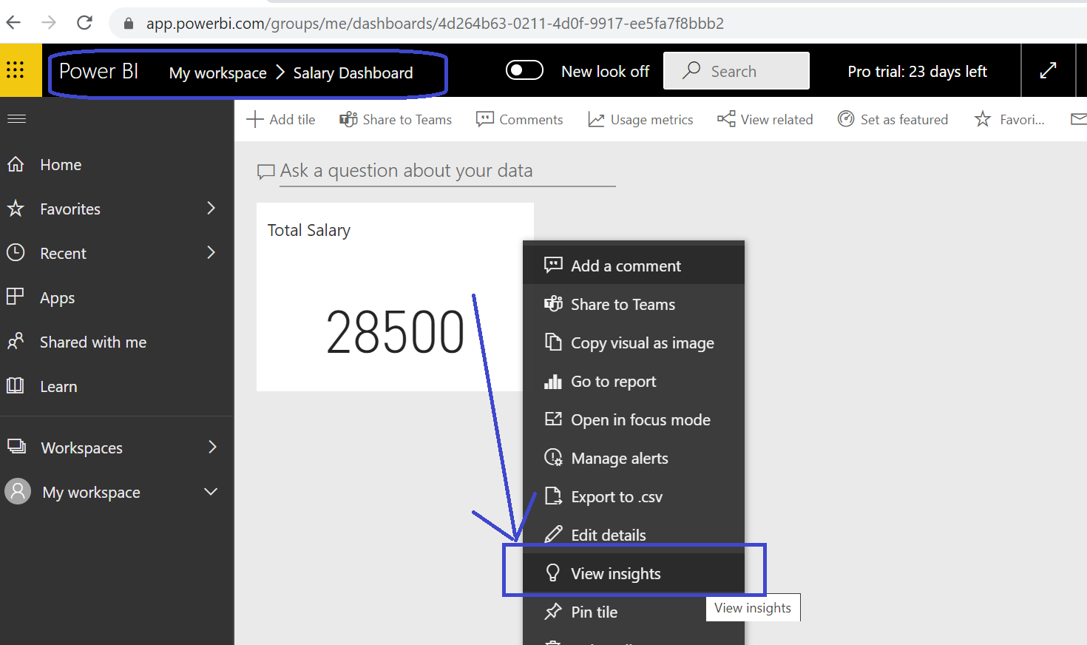
Method 1: Getting Insights from a Tile of an Existing Dashboard

Slide 5
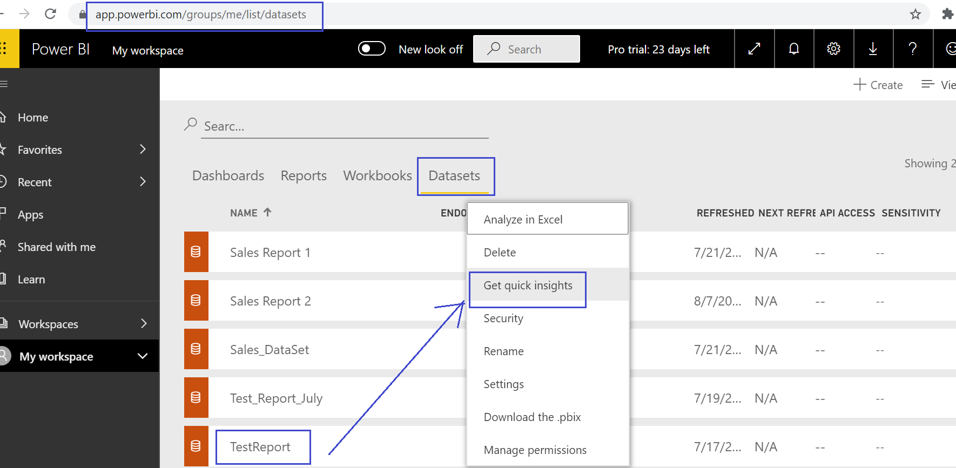
Method 2: Getting Insights directly from the Published DataSet

Slide 6
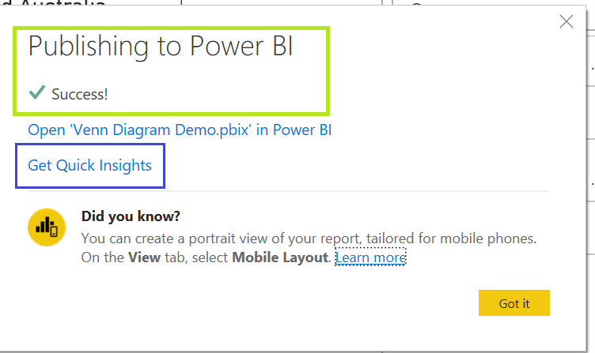
Method 3: Getting Insights directly after Publishing the Report

Slide 7
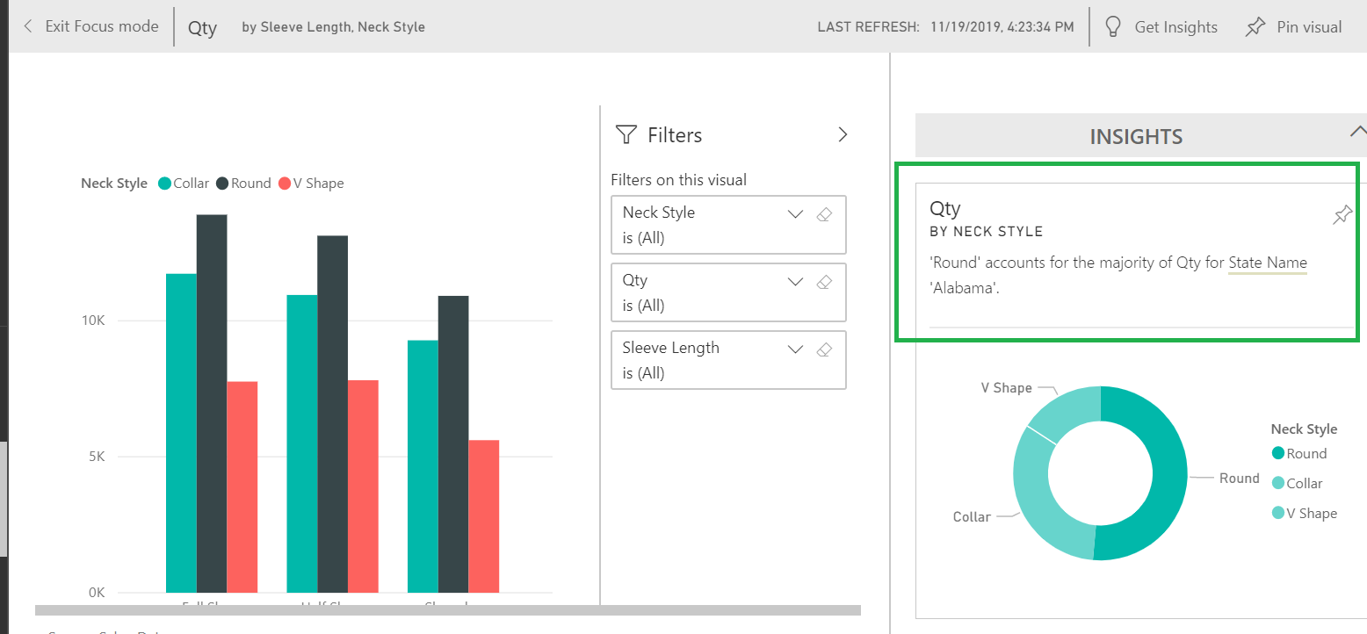
Insights given by Power BI – Example 1

Slide 8
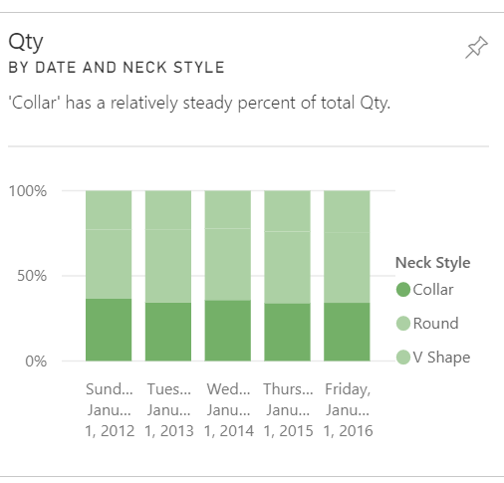
Insights given by Power BI – Example 2

Slide 9
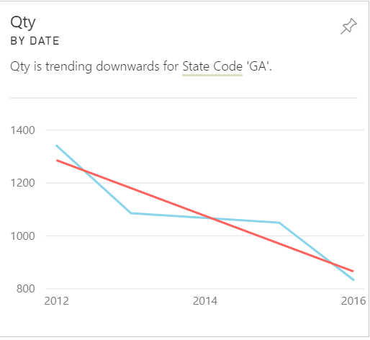
Insights given by Power BI – Example 3

Slide 10
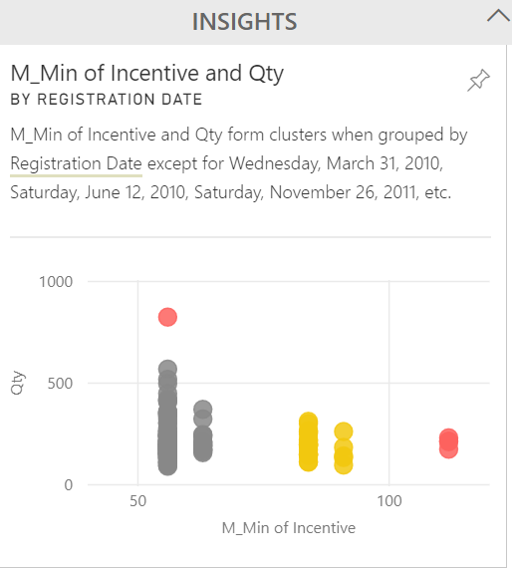
Insights given by Power BI – Example 4

Slide 11
How does it work????
The insights feature is built on a growing set of advanced analytical algorithms developed in conjunction with Microsoft Research that we’ll continue to use to allow more people to find insights in their data in new and intuitive ways.
Power BI quickly searches different subsets of your dataset. As it searches, Power BI applies a set of sophisticated algorithms to discover potentially interesting insights. Power BI scans as much of a dataset as possible in an allotted amount of time.

Slide 12
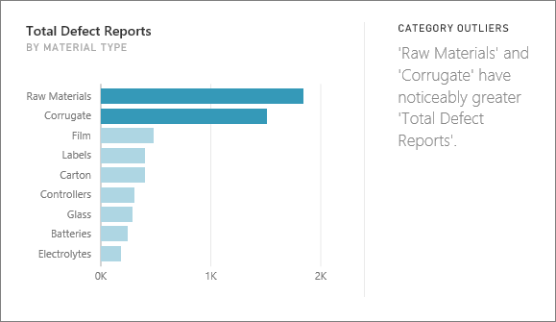
Technique 1 used in creating Insights
Category outliers (top/bottom)
Highlights cases where, for a measure in the model, one or two members of a dimension have much larger values than other members of the dimension.

Slide 13
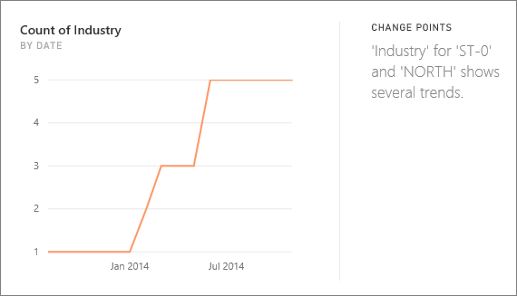
Technique 2 used in creating Insights
2. Change points in a time series
Highlights when there are significant changes in trends in a time series of data.

Slide 14
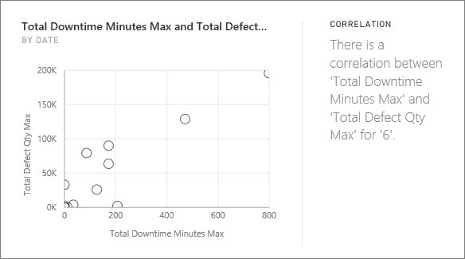
Technique 3 used in creating Insights
3. Correlation
Detects cases where multiple measures show a correlation between each other when plotted against a dimension in the dataset.

Slide 15
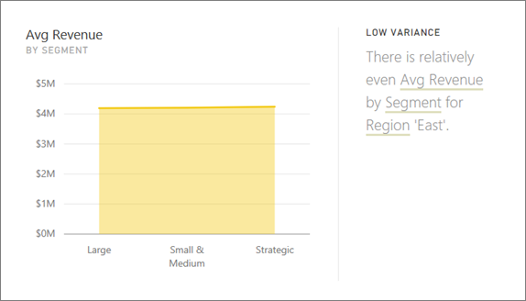
Technique 4 used in creating Insights
4. Low Variance
Detects cases where data points aren't far from the mean.

Slide 16
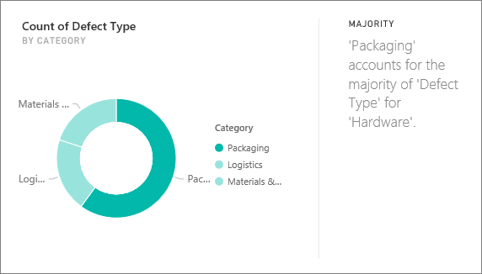
Technique 5 used in creating Insights
5. Majority (Major factors)
Finds cases where a majority of a total value can be attributed to a single factor when broken down by another dimension.

Slide 17
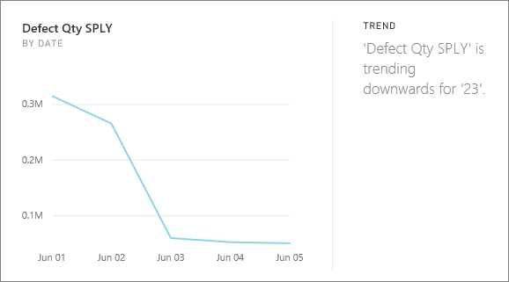
Technique 6 used in creating Insights
6. Overall trends in time series
Detects upward or downward trends in time series data.

Slide 18
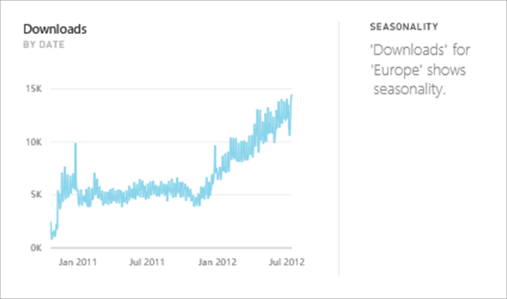
Technique 7 used in creating Insights
7. Seasonality in time series
Finds periodic patterns in time series data, such as weekly, monthly, or yearly seasonality.

Slide 19
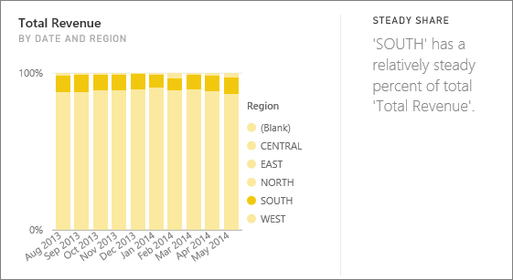
Technique 8 used in creating Insights
8. Steady share
Highlights cases where there is a parent-child correlation between the share of a child value in relation to the overall value of the parent across a continuous variable.

Slide 20
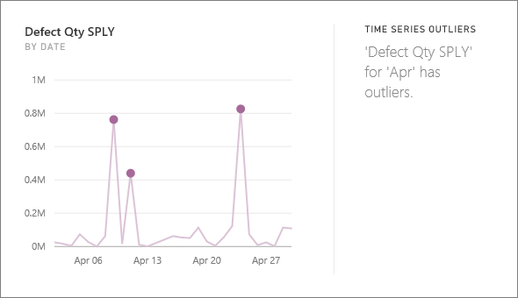
Technique 9 used in creating Insights
9. Time series outliers
For data across a time series, detects when there are specific dates or times with values significantly different than the other date/time values.

Slide 21
Last, But Not The Least
After getting the insights we can PIN that insight to the current or new Dashboard as well!!!!!

